Slide 1
OPERATING SYSTEMS (CS F372) Main Memory Management
Barsha Mitra
CSIS Dept., BITS Pilani, Hyderabad Campus

Slide 2
Background
Program must be brought into memory
Main memory and registers are only storage CPU can access directly
Memory unit only sees a stream of addresses + read requests, or address + data and write requests
Register access in one CPU clock (or less)
Main memory can take many cycles, causing a stall
Cache sits between main memory and CPU registers
Protection of memory required to ensure correct operation

Slide 3
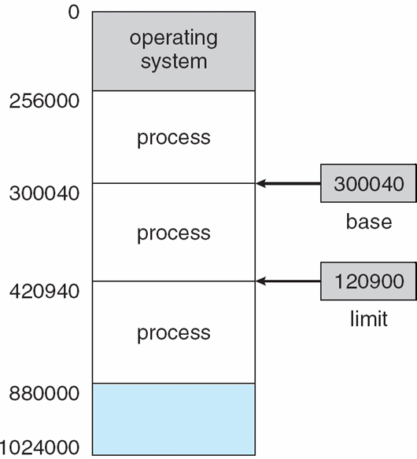
Base and Limit Registers
A pair of base and limit registers define the address space
CPU must check every memory access generated in user mode to be sure it is between base and limit for that user

Slide 4
Hardware Address Protection

Slide 5
Logical vs. Physical Address Space
Logical address – generated by the CPU; also referred to as virtual address
Physical address – address seen by the memory unit
Logical address space - set of all logical addresses generated by a program
Physical address space - set of all physical addresses corresponding to the logical addresses generated by a program

Slide 6
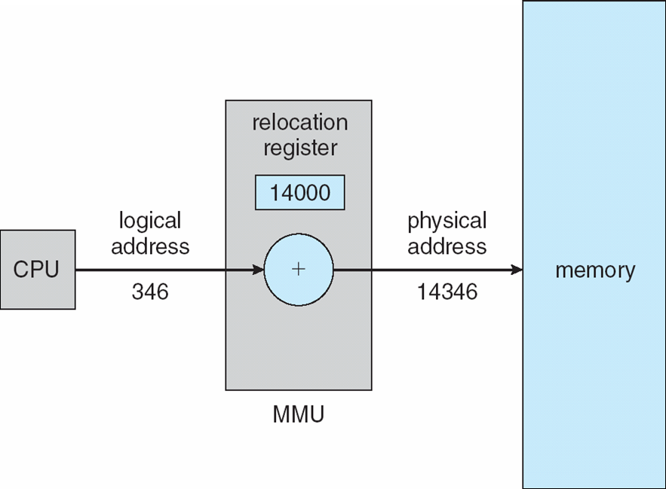
Memory-Management Unit (MMU)
Hardware device that at run time maps virtual address to physical address
The user program deals with logical addresses; it never sees the real physical addresses

Slide 7
Dynamic Loading
Routine is not loaded until it is called
Better memory-space utilization; unused routine is never loaded
All routines kept on disk
Useful when large amounts of code are needed to handle infrequently occurring cases

Slide 8
Swapping
A process can be swapped temporarily out of memory to a backing store, and then brought back into memory for continued execution
Total physical memory space of processes can exceed physical memory
Backing store – fast disk large enough to accommodate copies of all memory images for all users
Major part of swap time is transfer time
System maintains a ready queue of ready-to-run processes which have memory images on disk
Swap only when free memory extremely low
Swapping portions of processes

Slide 9
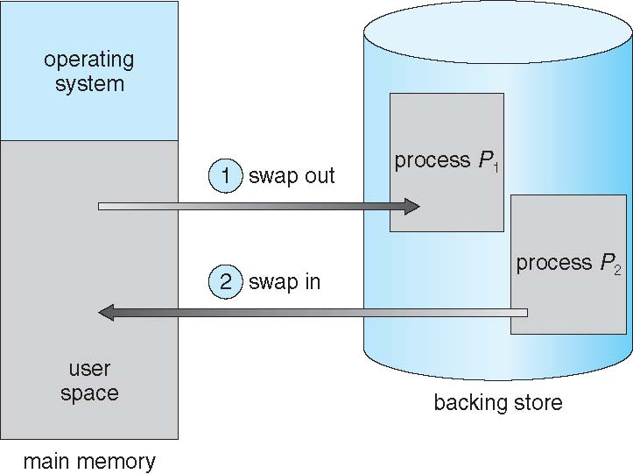
Swapping
If next processes to be put on CPU is not in memory, need to swap out a process and swap in target process
Context switch time can then be very high
100MB process swapping to hard disk with transfer rate of 50MB/sec
Swap out time of 2000 ms
Plus swap in of same sized process
Total context switch swapping component time of 4000ms (4 seconds)

Slide 10
Contiguous Memory Allocation
Relocation registers used to protect user processes from each other, and from changing operating-system code and data
Relocation register contains value of smallest physical address
Limit register contains range of logical addresses – each logical address must be less than the limit register
MMU maps logical address dynamically

Slide 11
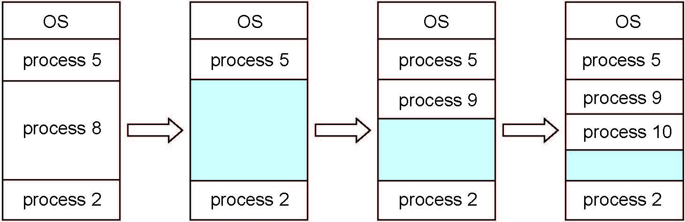
Multiple-Partition Allocation
Fixed size partitions, Degree of multiprogramming limited by number of partitions
Variable-partition sizes for efficiency (sized to a given process’ needs)
Hole – block of available memory; holes of various size are scattered throughout memory
When a process arrives, it is allocated memory from a hole large enough to accommodate it
Process exiting frees its partition, adjacent free partitions combined
Operating system maintains information about: a) allocated partitions b) free partitions (hole)

Slide 12
Dynamic Storage-Allocation Problem
How to satisfy a request of size n from a list of free holes?
First-fit: Allocate the first hole that is big enough
Best-fit: Allocate the smallest hole that is big enough; must search entire list, unless ordered by size
Produces the smallest leftover hole
Worst-fit: Allocate the largest hole; must also search entire list
Produces the largest leftover hole
First-fit and best-fit better than worst-fit in terms of speed and storage utilization

Slide 13
Problem
Given six memory partitions of 300 KB, 600 KB, 350 KB, 200 KB, 750 KB, and 125 KB (in order), how would the first-fit, best-fit, and worst-fit algorithms place processes of size 115 KB, 500 KB, 358 KB, 200 KB, and 375 KB (in order)? Note: When hole is created it is treated as independent partition.
First Fit:
Best Fit:
Worst Fit
300KB 600KB 350KB 200KB 750KB 125KB
300KB 600KB 350KB 200KB 750KB 125KB
300KB 600KB 350KB 200KB 750KB 125KB

Slide 14
Fragmentation
External Fragmentation – total memory space exists to satisfy a request, but it is not contiguous
Reduce external fragmentation by compaction
Shuffle memory contents to place all free memory together in one large block
Allow logical address space of processes to be non-contiguous
Internal Fragmentation – allocated memory may be slightly larger than requested memory; this size difference is memory internal to a partition, but not being used

Slide 15
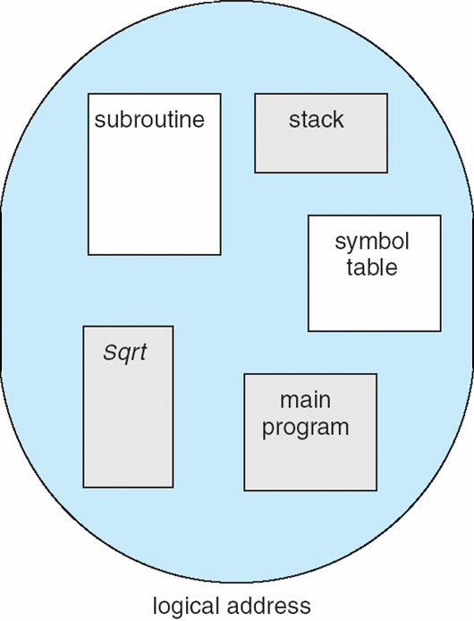
Segmentation
A program is a collection of variable sized segments
A segment is a logical unit such as:
main program
procedure
function
method
object
Memory-management scheme that supports user view of memory
Logical address space is a collection of segments
local variables, global variables
stack
symbol table
arrays

Slide 16
Segmentation Architecture
Logical address consists of a two tuple: <segment-number, offset>
Segment table – maps logical addresses to physical addresses; each table entry has:
segment base – contains the starting physical address where the segment resides in memory
segment limit – specifies the length of the segment
Segment-table base register (STBR) points to the segment table’s location in memory
Segment-table length register (STLR) indicates number of segments used by a program

Slide 17
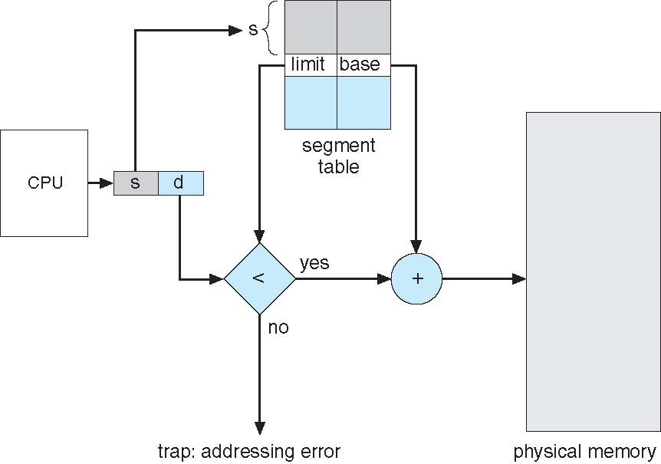
Segmentation Hardware

Slide 18
Paging
Physical address space of a process can be noncontiguous; process is allocated physical memory whenever the latter is available
Avoids external fragmentation
Avoids need for compaction
Divide physical memory into fixed-sized blocks called frames
Size is power of 2
Divide logical memory into blocks of same size called pages
Keep track of all free frames
To run a program of size N pages, need to find N free frames and load program
Set up a page table to translate logical to physical addresses
Still have Internal fragmentation

Slide 19
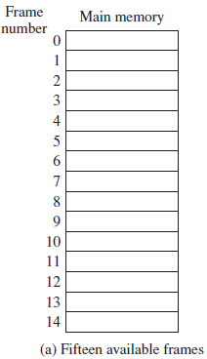
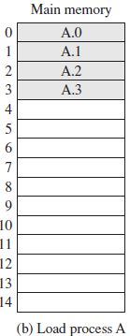
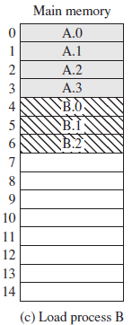
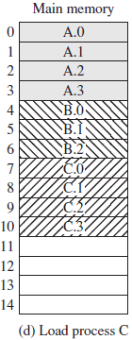
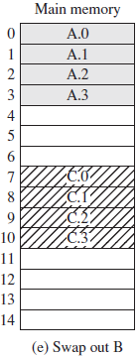
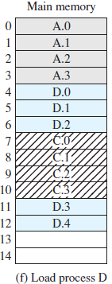
Example
Process A : 4 pages
Process B : 3 pages
Process C : 4 Pages
Process D : 5 Pages
Main Memory : 15 frames

Slide 20
Address Translation Scheme
Address generated by CPU is divided into:
Page number (p) – used as an index into a page table which contains base address of each page in physical memory
Page offset (d) – combined with base address to define the physical memory address that is sent to the memory unit
logical address space 2^{m} bytes and page size 2^{n} bytes

Slide 21
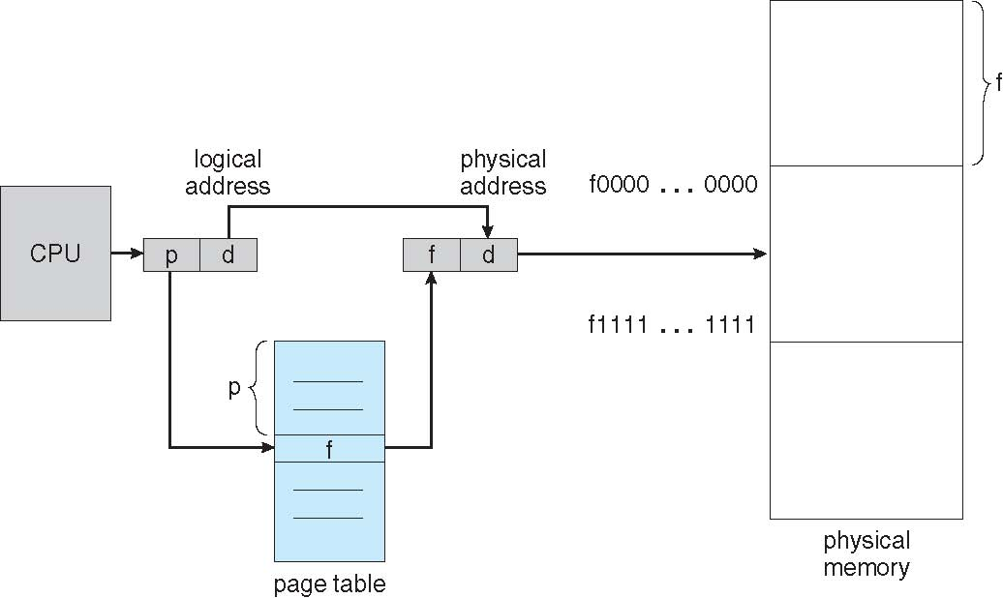
Paging Hardware
page table contains base address of each frame in physical memory

Slide 22
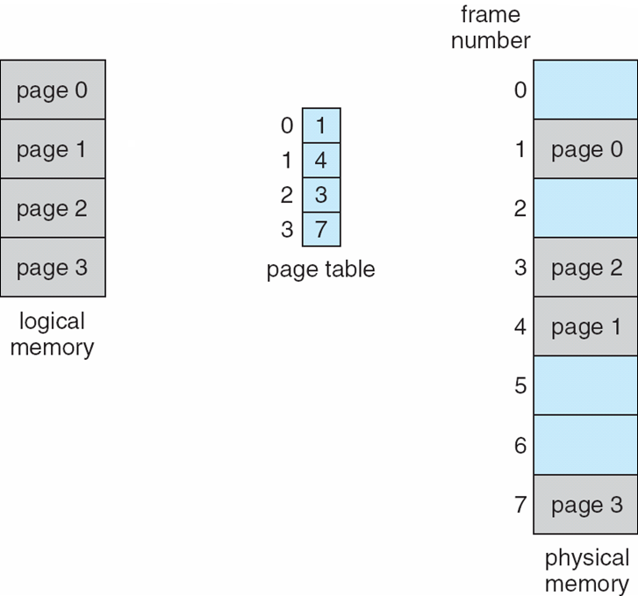
Paging Model of Logical and Physical Memory

Slide 23
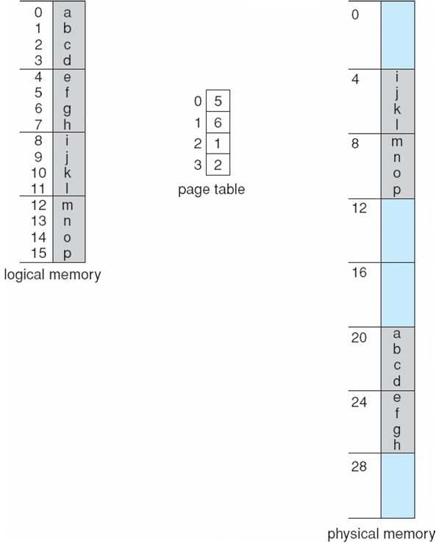
Paging Example
n = 2 and m = 4
32-byte memory and 4-byte pages

Slide 24
Paging
Internal fragmentation
So small frame sizes desirable?
But each page table entry takes memory to track

Slide 25
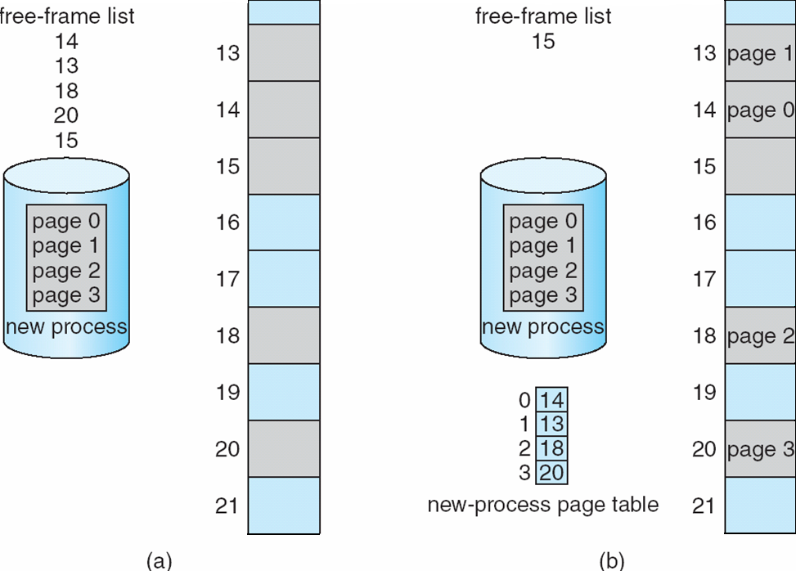
Free Frames
Frame table – one entry for each frame indicating whether the frame is free or allocated and if allocated, to which page of which process
Before allocation
After allocation

Slide 26
Page Table Implementation
Page table is kept in main memory
Page-table base register (PTBR) points to the page table
Page-table length register (PTLR) indicates size of the page table
In this scheme every data/instruction access requires two memory accesses
One for the page table and one for the data / instruction
The two memory access problem can be solved by the use of a special fast-lookup hardware cache called associative memory or translation look-aside buffers (TLBs)

Slide 27
Associative Memory
Associative memory – parallel search
Address translation (p, d)
If p is in associative memory, get frame # out
Otherwise get frame # from page table in memory

Slide 28
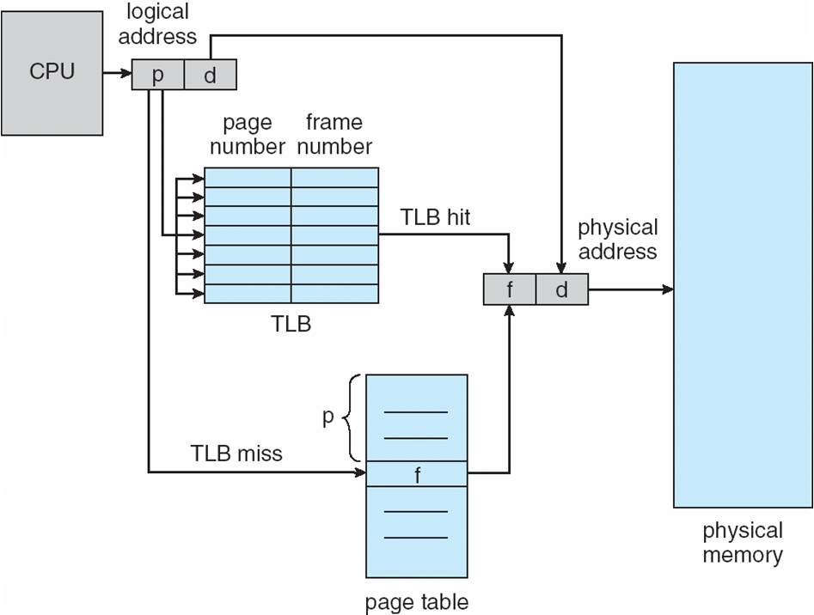
Paging Hardware With TLB

Slide 29
Effective Access Time
Associative Lookup = ε time unit
Hit ratio = α
Hit ratio – percentage of times that a page number is found in the associative memory
Consider α = 80%, ε = 20ns for TLB search, 100ns for memory access
Effective Access Time (EAT)
Consider α = 80%, ε = 20ns for TLB search, 100ns for memory access
EAT = 0.80 x 120 + 0.20 x 220

Slide 30
Problem
Consider a logical address space of 32 pages of 1,024 bytes each, mapped onto a physical memory of 64 frames.
How many bits are there in the logical address?
How many bits are there in the physical address?
Notes:
LM: 16 bits
PM : 15 bits

Slide 31
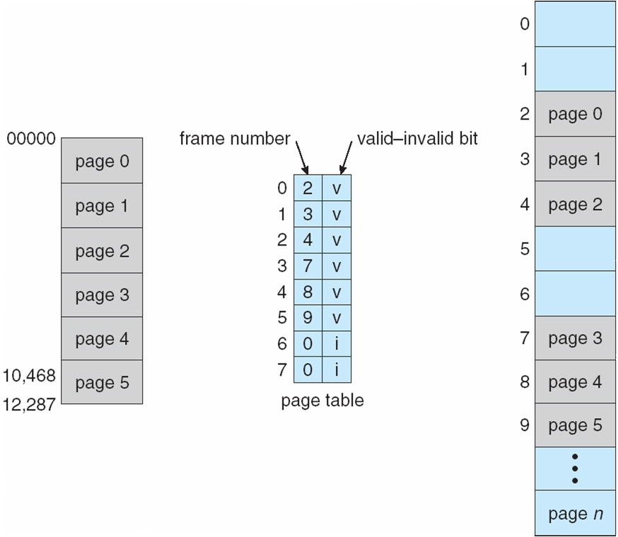
Memory Protection
Memory protection implemented by associating protection bit with each frame to indicate if read-only or read-write access is allowed
Can also add more bits to indicate page execute-only, and so on
Valid-invalid bit attached to each entry in the page table:
“valid” indicates that the associated page is in the process’s logical address space, and is thus a legal page
“invalid” indicates that the page is not in the process’s logical address space
Any violations result in a trap to the kernel

Slide 32
Page Table Structure
Memory structures for paging can get huge using straight-forward methods
Cost a lot
Don’t want to allocate that contiguously in main memory
Hierarchical Paging
Hashed Page Tables
Inverted Page Tables

Slide 33
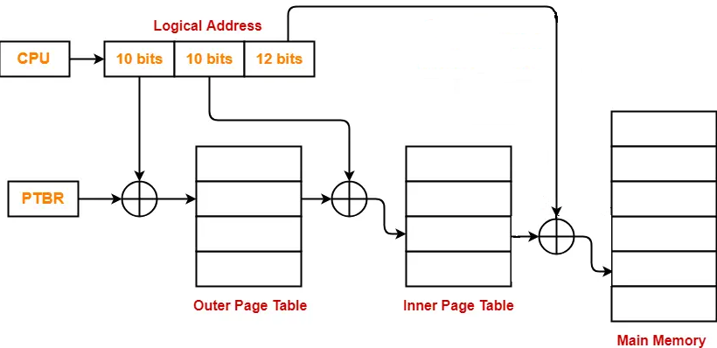
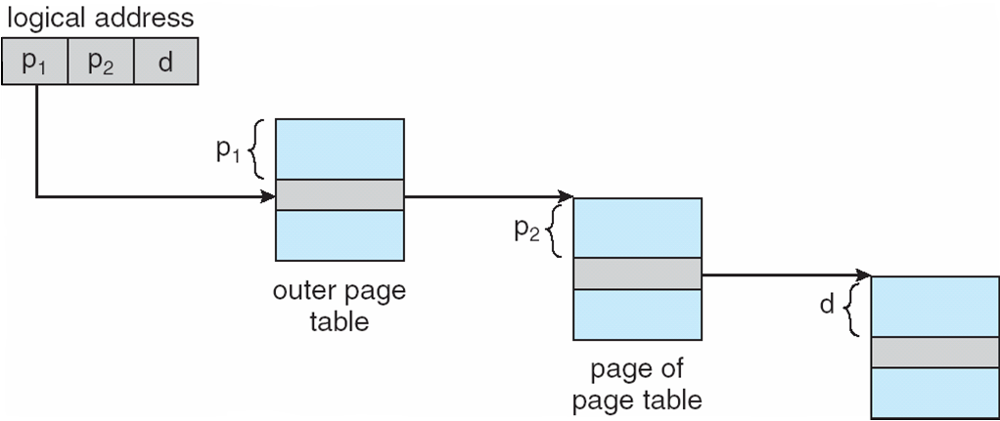
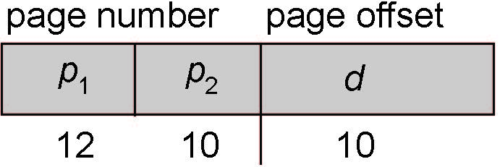
Hierarchical Page Tables
Break up the logical address space into multiple page tables
Two-level page table
We then page the page table
p₁ is an index into the outer page table, and p₂ is the displacement within the page of the inner page table

Slide 34
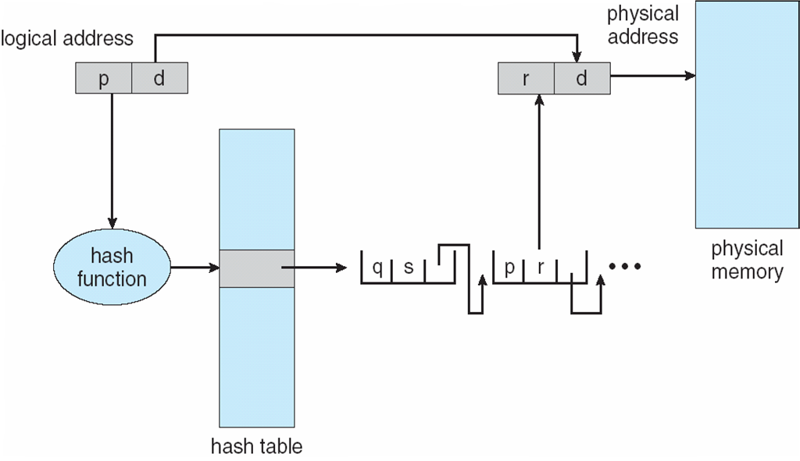
Hashed Page Table
The page number is hashed
Page table contains a chain of elements hashing to the same location
Each element contains (1) page number (2) value of the mapped page frame (3) a pointer to the next element
Page numbers are compared in this chain searching for a match
If a match is found, the corresponding physical frame is extracted

Slide 35
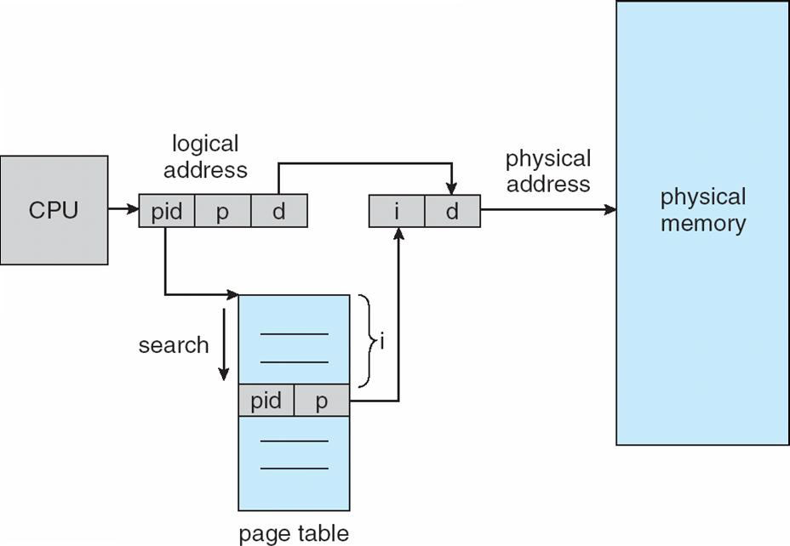
Inverted Page Table
Track all physical pages
One entry for each real page of memory
Entry consists of the virtual address of the page stored in that real memory location, with information about the process that owns that page

Slide 36
Thank You

